Slide 1

CALLED TO BE FAITHFUL: THE FAITH OF JESUS
BIBLE STUDY 2

Slide 2
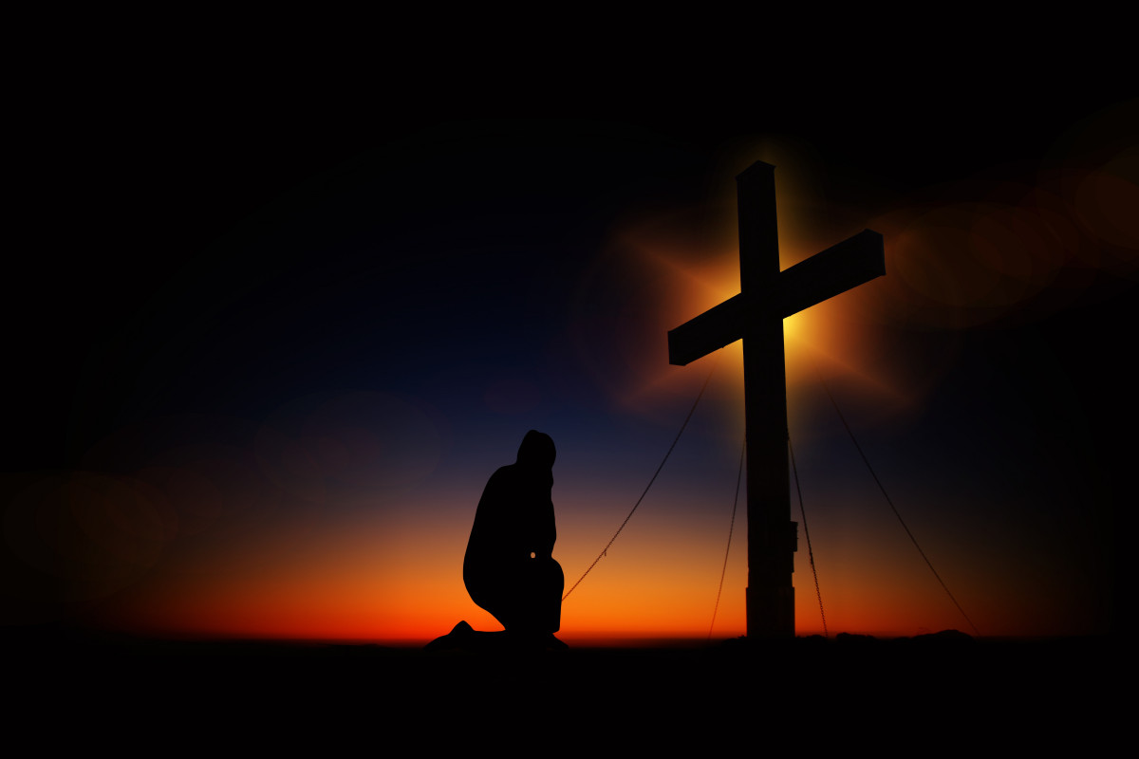
Introduction
Our lesson is presented in three phases:
The faith in Jesus
The faith of Jesus
The faith in Jesus in the New Testament.
Notes:
In this lesson, we will look at the topic “Called to be faithful: The faith of Jesus.” We will address the meaning of the phrase “The faith of Jesus” from the perspective of the Bible. Our lesson is presented in three phases, namely, (1) The faith of Jesus, (2) The faith in Jesus, and (3) The faith in Jesus in the New Testament. This lesson will initially address the overarching theme from a New Testament viewpoint and subsequently focus on the end-time audience as depicted in the book of Revelation, aiming to relate it to our modern understanding of the faith of Jesus.

Slide 3
The Faith of Jesus
In the New Testament, the phrase “the faith of Jesus” can be interpreted to mean either followers of Jesus are enjoined to fully express and demonstrate trust in Jesus’ saving act
(John 3:16. Acts 16:31, 20:21, 24:24; Rom 3:22,26; Gal 2:20; Eph 3:12; Phil 3:8;)
or Jesus’ fulfillment of His word to the Father and subsequently His followers
(Luke 2:49; John 5:30; John 6:38; John 8:29; John 14:31; 2 Tim 2:11-13;Heb 3:2,6; 1 John 1:9).
Notes:
Let’s expand on the second first.

Slide 4
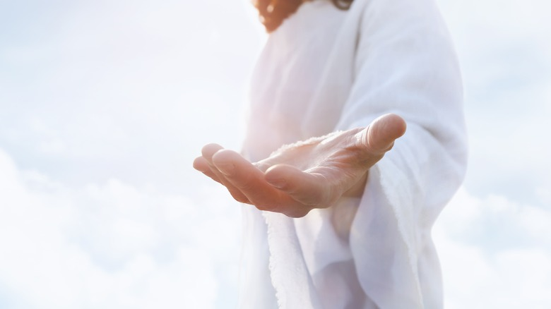
Jesus demonstrates what faith is.
The word “faith” is a translation of the Greek pistis.
In Greek culture, pistis conveys the concept of trust and reliability gained because of a persuasive argument or act.

Slide 5

The trust shown embodies the entire being of the person trusting.
There is not an iota of second thought.
Notes:
For example, children eat food offered by their mothers with no thought of their mothers harming them. It is this kind of trust we are talking about. We can relate to the trust we have for the foods sold in the market or on the street.

Slide 6
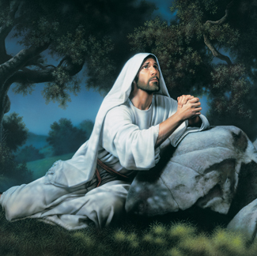
Jesus entrusted Himself to the Father in all matters and in all ways without an iota of second thought.
Thus, Jesus sought to demonstrate His faithfulness in obedience (Mark 1:38; Luke 4:43; John 14:4; 19:30; Heb 2:17-18; 3:6).

Slide 7
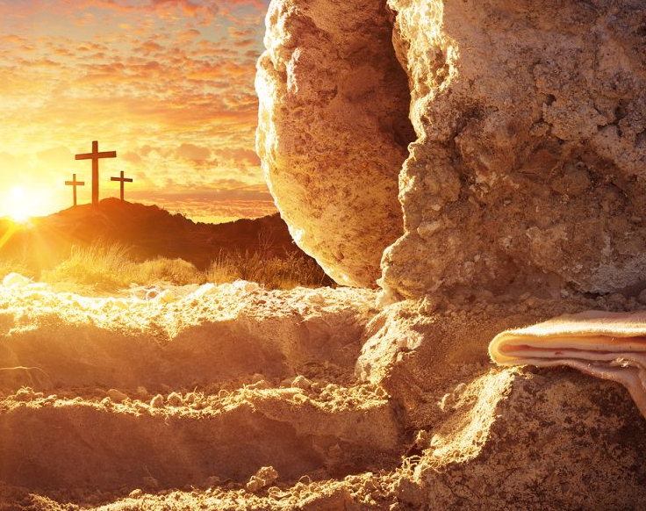
He trusted that the Father would raise Him from the dead (Acts 3:15, 26; 4:10; John 10:18; Rom 8:11; Gal 1:1).
Notes:
Jesus gave Himself up at Gethsemane, saying, “Father, if it is Your will, take this cup away from Me; nevertheless, not My will, but Yours, be done” (Luke 22:42, NKJV). Indeed, He was raised on the third day, confirming the reliability of the Father and Jesus’ words. Hence, the Father and Jesus are reliable and trustworthy.

Slide 8

This faith Jesus had in God influenced His diligence in accomplishing the mission of the Father (Mark 1:38; Luke 4:43; John 4:34; 9:4; 12:27; 17:4; 19:30; Heb 2:17-18).
Notes:
Though God, when He became human like us, Jesus was to bear the consequences of our disobedience, which was eternal separation from God, our source of life and sustenance. He accomplished this task with the hope of being lifted first among humans to sit at the right side of God.

Slide 9

He was steadfast and focused, and nothing distracted Him from getting to the goal, though the devil attempted to dissuade Him with temporal and vague honor
(Matt 4:1-11; Heb 12:1-7).
Notes:
Here, we see that faithfulness attracts distractions. In short, we can say that God the Father was the reliable evidence that Jesus relied on in His work and His future.

Slide 10
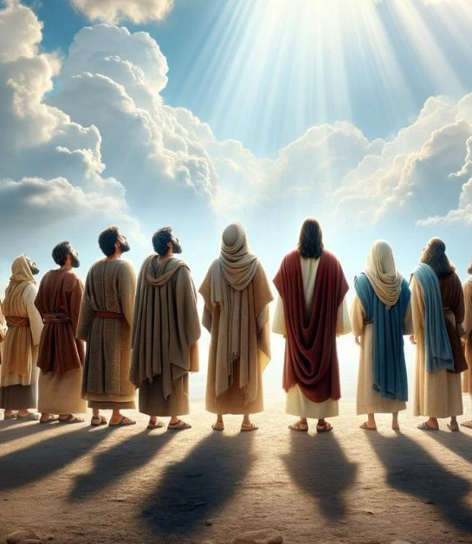
Jesus was faithful to His followers.
He promised them the outpouring of the Holy Spirit, and it happened at Pentecost and on different occasions
(Luke 24:49; John 14:16, 26; 15:26; 16:7; Acts 1:4, 8; 2:38-39; 10:44-46; Rom 5:5; 1 Cor 12:7; Eph 4:11-13).
Notes:
He promised His presence in their proclamation of the Gospel, and they experienced it as they healed the sick in His name and died in His presence (Acts 3:6-16; 7:55-60).

Slide 11
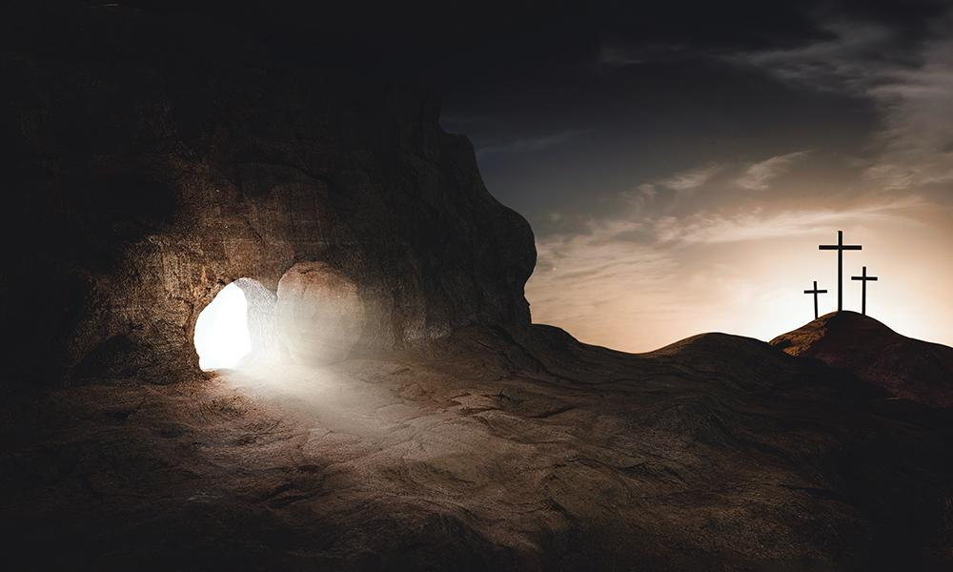
Ultimately, His promise of death and resurrection was fulfilled and was witnessed by the followers
(Matt 12:39-40; John 2:18-22; 10:17-18; Rom 8:11; 1 Cor 15:1-11; Phil 3:10-11; 1 Thess 4:14).
Notes:
This fulfillment gives evidence upon which the followers of Jesus are to express faith.

Slide 12
The Faith in Jesus
Jesus is the subject of the expression “the faith of Jesus,” indicating His faithfulness to God the Father in accomplishing the task assigned to Him, “the faith in Jesus” conveys a faith-relationship to Jesus. And Jesus is the example of how this faith is expressed (1 Pet 2:21).
Notes:
“The faith of Jesus” provides a template for understanding “the faith in Jesus” in reverse. Whereas Jesus is the subject of the expression “the faith of Jesus,” indicating His faithfulness to God the Father in accomplishing the task assigned to Him, “the faith in Jesus” conveys a faith-relationship to Jesus. And Jesus is the example of how this faith is expressed (1 Pet 2:21).

Slide 13
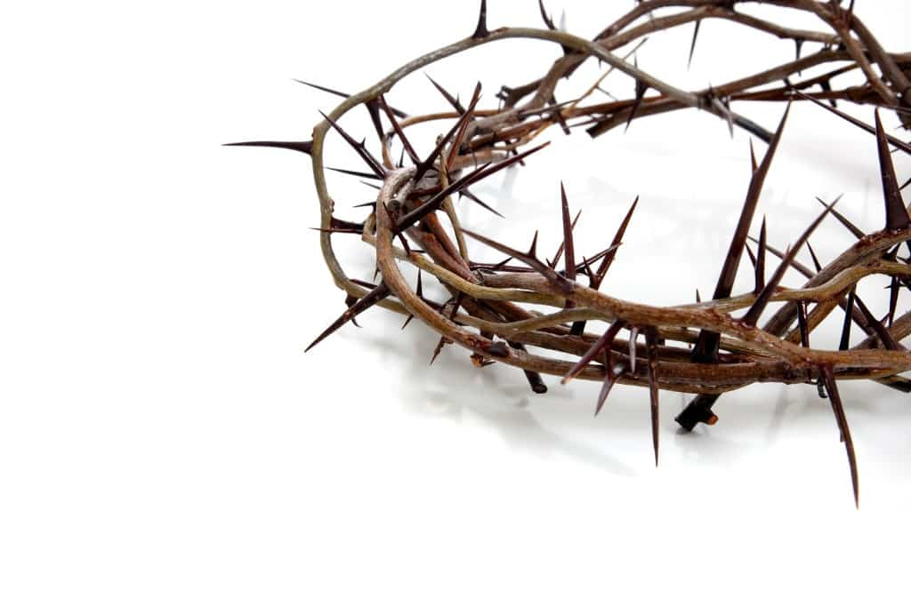
We love Him because He first loved us” (1 John 4:19, NIV).
Notes:
Apostle John beautifully paints this relationship this way: “We love Him because He first loved us” (1 John 4:19, NIV).

Slide 14
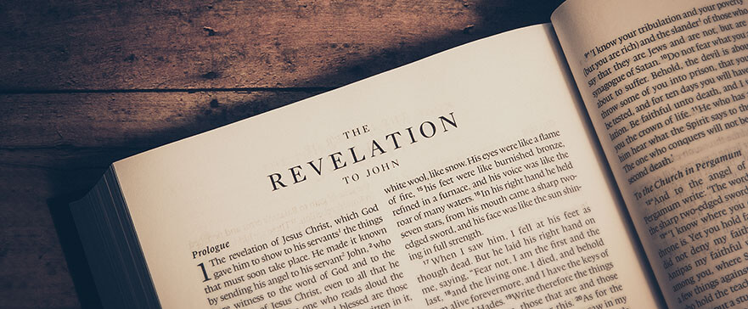
In the book of Revelation, those who will not be burnt in fire with the beast are the ones having “the faith in Jesus” and keeping the commandments of God (14:12).
Notes:
We will focus on our phrase, as another lesson will deal with the “commandments of God.” It is best to interpret the phrase in the context of the purpose of the book as well as the New Testament

Slide 15
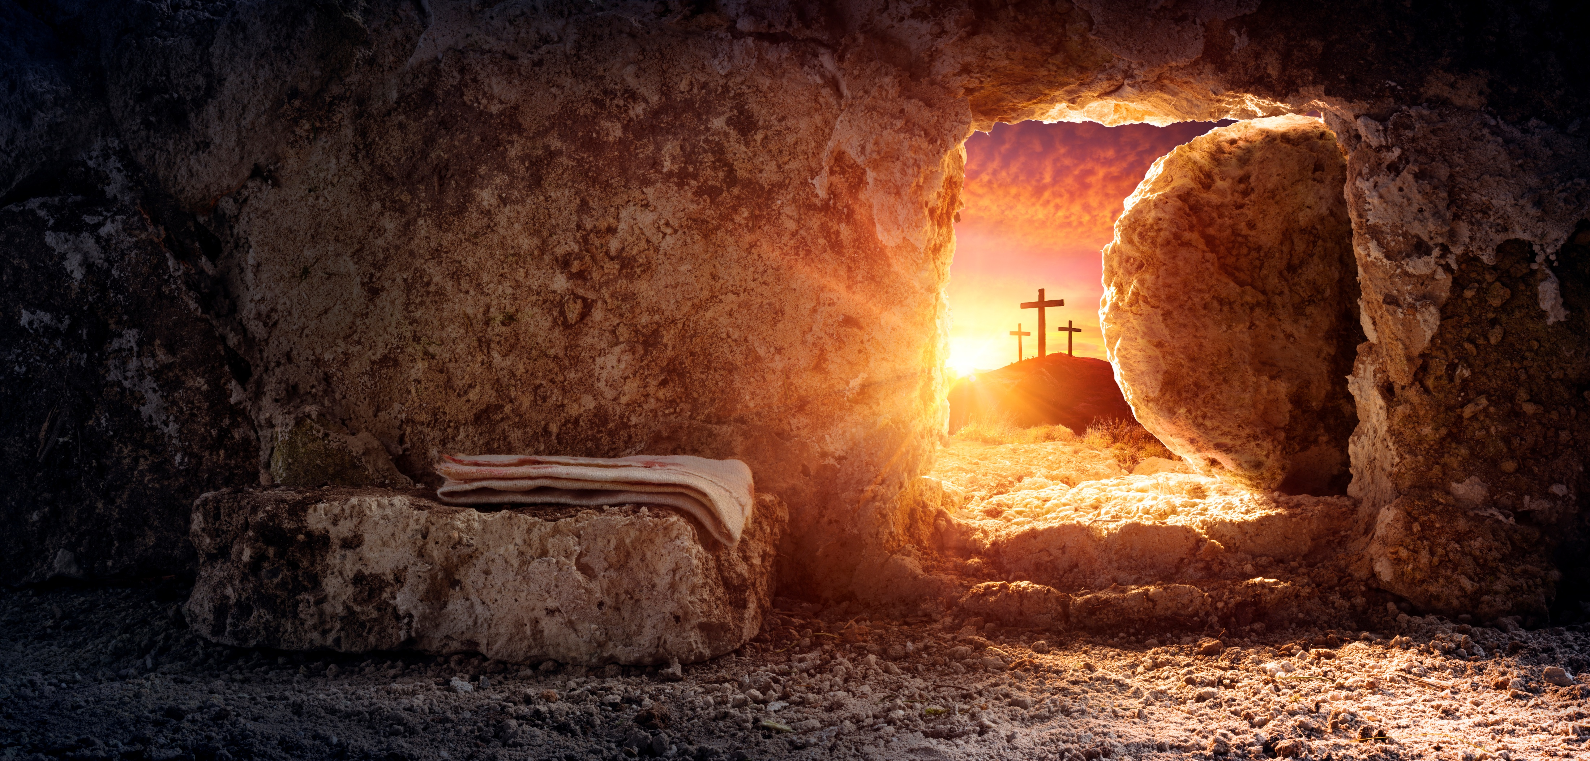
God, through the resurrected Jesus Christ, revealed and affirmed His promise to end sin and live among human beings (Rev 1:1-3; 11:11; 21:1-7).
Notes:
He assured the immediate audience (the seven churches in Asia Minor and believers throughout world history) of His presence as they are distracted by the vain glory that the world imposes on them and suffering for Christ’s sake (2-3; 6:9-11; 13:10; 16:2; 17:14; 19:1-9

Slide 16

The immediate audience faced two issues: compromising their allegiance to Christ alone by yielding to idol worship and persecution, and entertaining false teachings, which replaced divinely empowered living with self-righteous living (2:5, 10, 14-15, 20-21, 24; 3:3, 17-18).

Slide 17

Revelation 14:12 is understood in the block of chapters 12-14.
Notes:
The block paints a picture of the background and the high point of the great controversy where rebellion is finally crushed.

Slide 18

Chapter 14:12 gives hope to those with the name of God on their foreheads (v. 1). These people are end-time believers who will experience the final onslaught of the devil.
Notes:
What sets them apart from those who received the mark of the beast is their disposition to keep God’s commandments and have faith in Jesus. Let us see how the rest of the New Testament views “the faith in Jesus” to appreciate our response to God’s word.

Slide 19
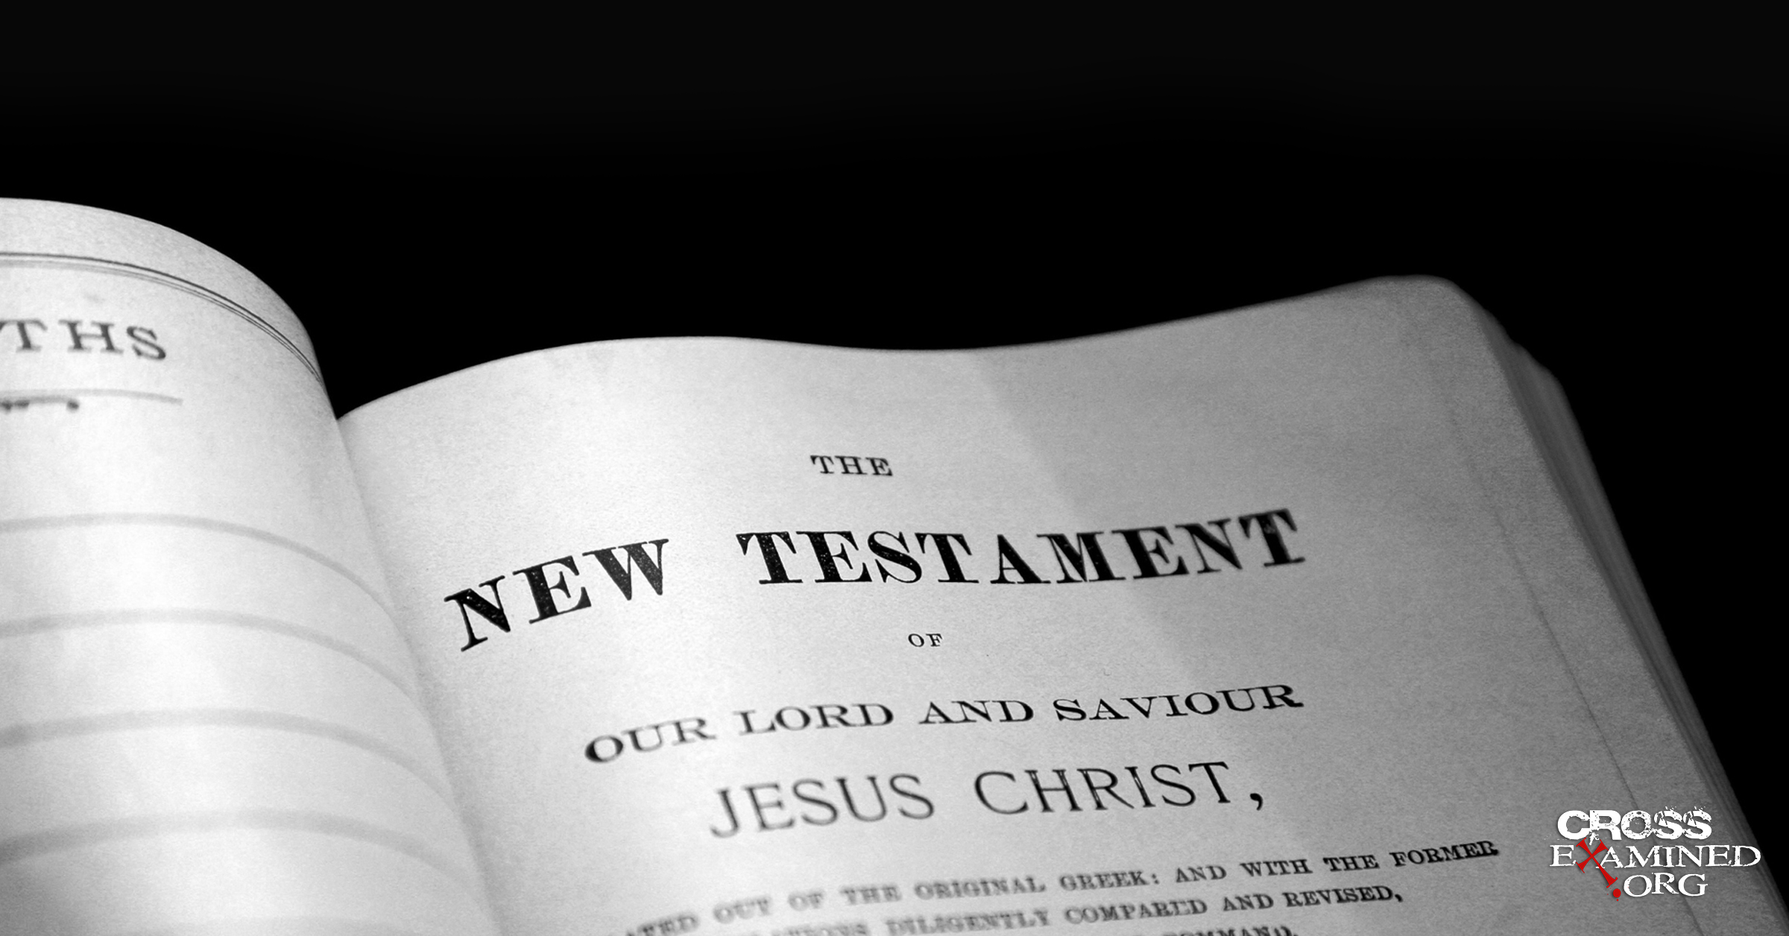
“The faith in Jesus” in the New Testament

Slide 20
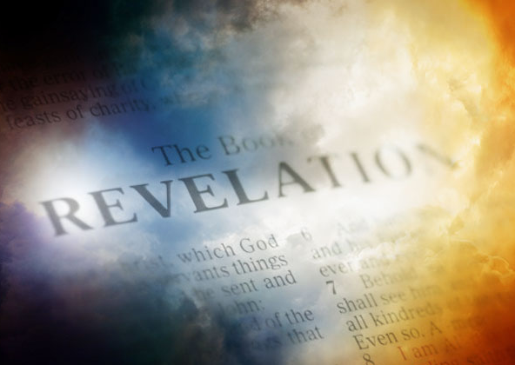
The book of Revelation was primarily written to believers (1:1-3) and for the world (14:6-11).
The message of the book presupposes the teachings of the rest of the New Testament. One of these teachings is “faith in Jesus.”

Slide 21
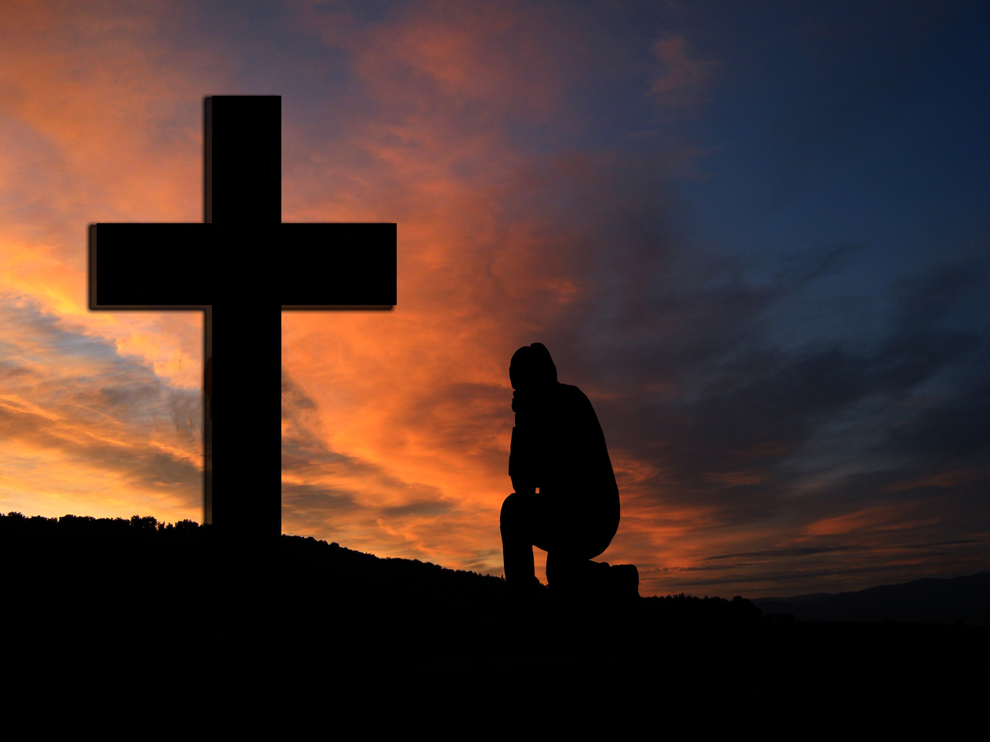
The New Testament teaches that anyone who confesses that Jesus is the Son of God who died and resurrected receives salvation
(John 3:16; 2 Cor 5:21; ).

Slide 22

Once saved by expressing this faith with a public declaration through baptism, one becomes a new creation and a bondservant who will be under construction by God to be conformed into the image of Christ Jesus (Rom 8:29a; 2 Cor 5:15, 17; Phil 2:13).

Slide 23

This new creation must show evidence that one has been born from above and reflect one’s heavenly Father on earth
(Matt 5:13-16, 43-48; Gal 5:).
There should be intentionality to cooperate with God to work on bad habits that dishonor your Father in heaven
(Phil 2:12-13).

Slide 24
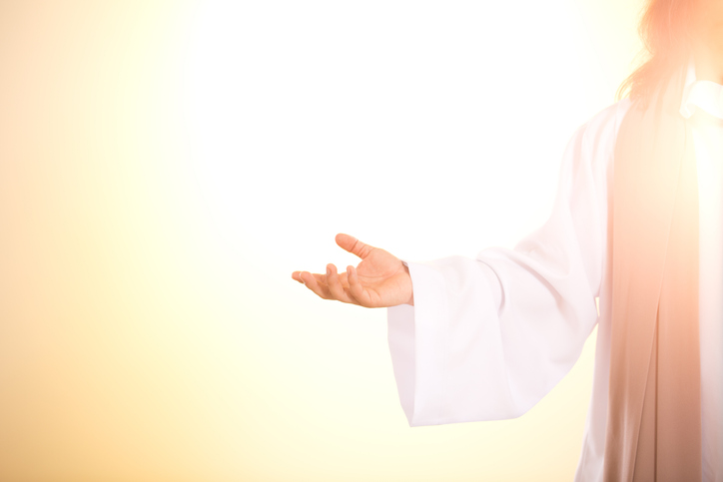
We have been called to fully entrust ourselves to God to honor His name while attending to our needs. He knows our needs before we tell Him.

Slide 25
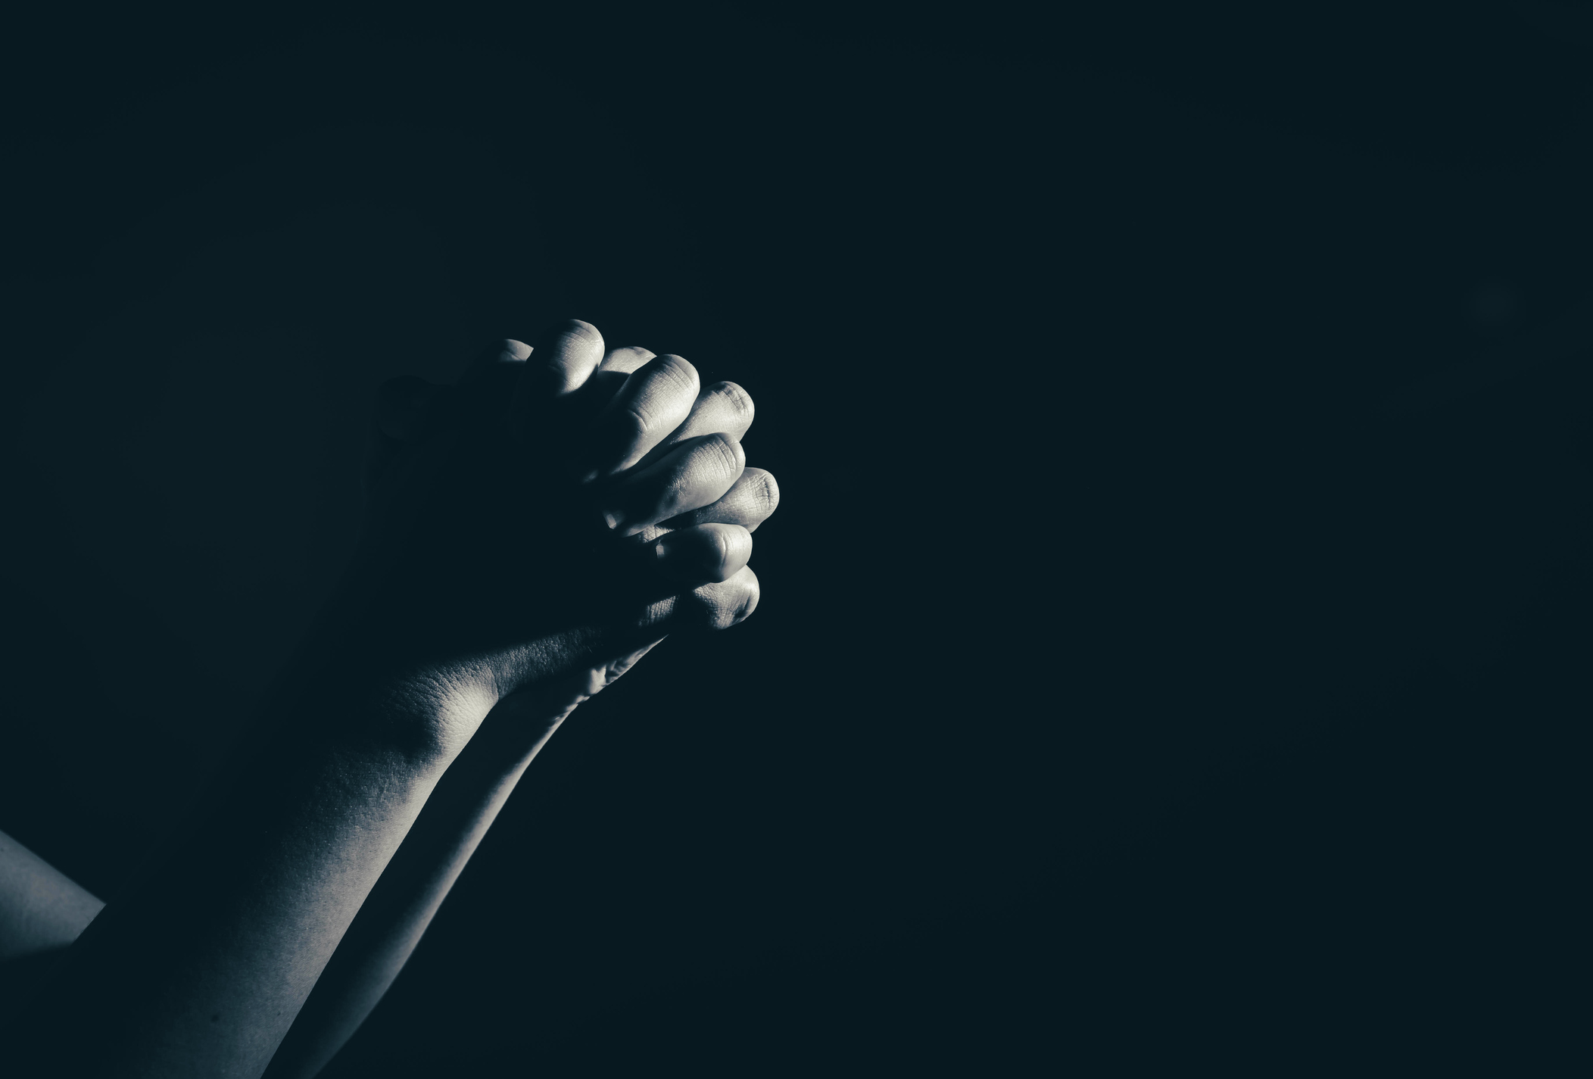
Prayer is intended to help us develop the attitude of humility, which is being mindful of not feeling self-sufficient but rather acknowledging that our sufficiency is entirely dependent on God in all matters of life
(Josh 1:7-8; Prov 3:5-6; Matt 6:8-9; Eph 5:10-17).

Slide 26

The Spirit of God that lives in an apostle, pastor, church elder, or ordinary member who believes in Christ is the same; hence, we should not put our trust in human beings to get our needs answered by God.
Talk to God because He is your Father too, and trust in His wisdom (1 John 4:19).

Slide 27

To have “faith in Jesus” also means that believers remain faithful stewards in the proclamation of the gospel of salvation in Jesus Christ. We have the truth about the meaning of life: “Now this is eternal life: that they know you, the only true God, and Jesus Christ, whom you have sent” (John 17:3, NIV).

Slide 28
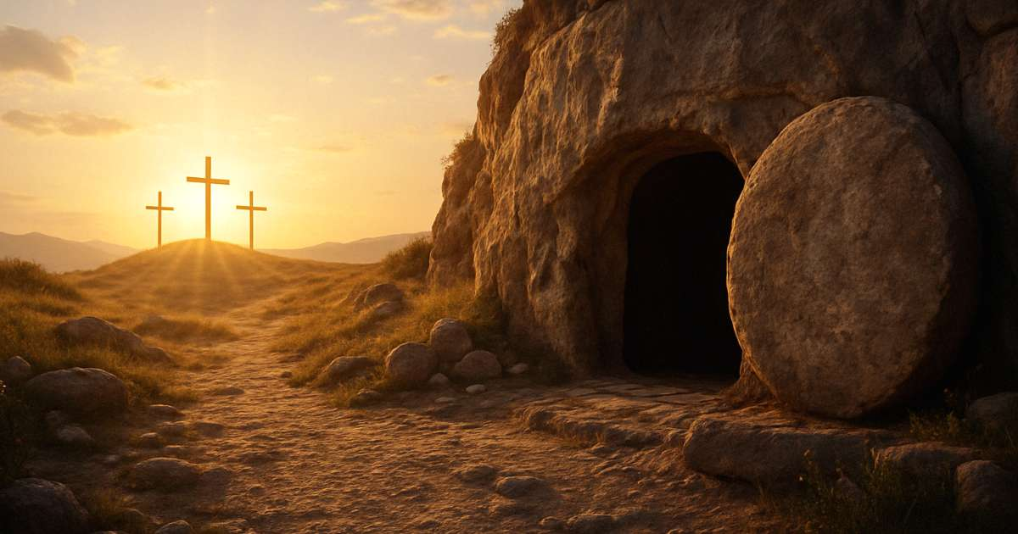
Believers are mandated to make this truth known as a mark of our faithfulness to Jesus, our Master
(Matt 28:18-20; 1 Cor 15:1-11; 2 Tim 2:1-8; 1 Pet 3:15).
This will also require faithful church leadership responsibility and commensurate respect for the leaders by the members
(Acts 20:28; 1 Tim 5:17-18; 1 Pet 5:1-6).

Slide 29
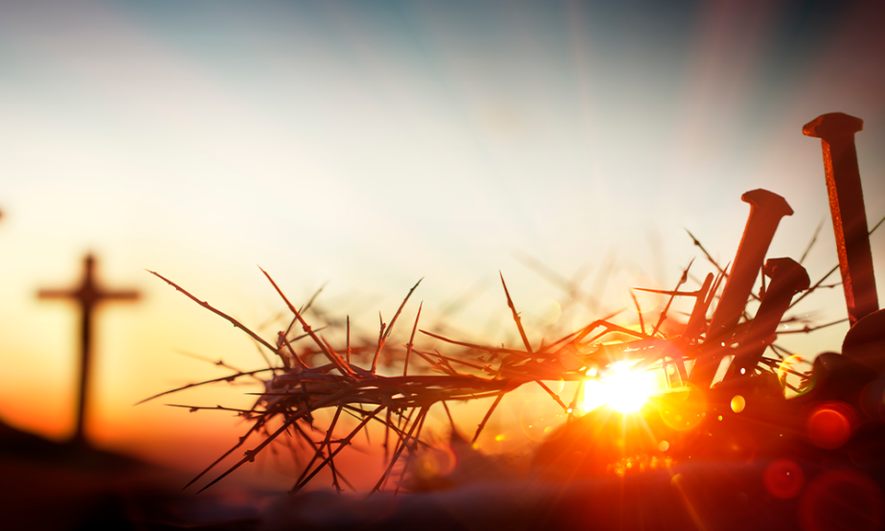
As end-time people saved by the blood of Jesus and awaiting His glorious appearance, we have been called to remain faithful to Jesus.

Slide 30

As Seventh-day Adventists, we have the burden to announce to the world that the only Savior of the world is on His way to end chaos and establish peace.
We are privileged to have this truth, and many are dying without it.
Notes:
To make sense of our faith in Jesus requires us to grow in the grace and the knowledge of our Lord and Savior Jesus Christ so as not to be distracted because OUR KING IS NEAR [2 Pet 3:18].

Slide 31
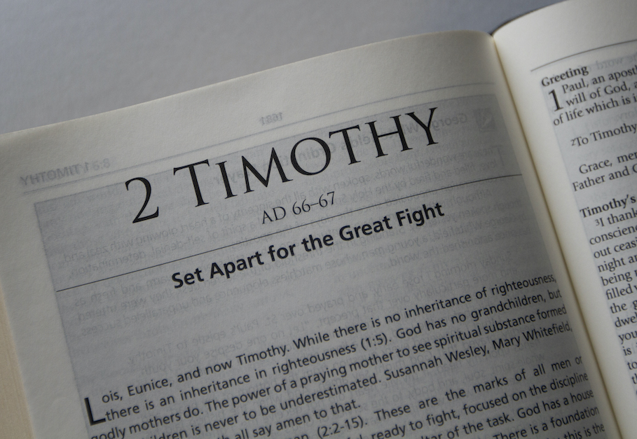
Conclusion
(2 Tim 2:11-13, NIV).

